Slide 1
Sorting Algorithms and their Efficiency
Chapter 11
Data Structures and Problem Solving with C++: Walls and Mirrors, Carrano and Henry, © 2013

Slide 2
Contents
Basic Sorting Algorithms
Faster Sorting Algorithms
A Comparison of Sorting Algorithms
Data Structures and Problem Solving with C++: Walls and Mirrors, Carrano and Henry, © 2013

Slide 3
Basic Sorting Algorithms
Sorting is:
  A process
  It organizes a collection of data
  Organized into ascending/descending order
Internal: data fits in memory
External: data must reside on secondary storage
Sort key: data item which determines order
Data Structures and Problem Solving with C++: Walls and Mirrors, Carrano and Henry, © 2013

Slide 4
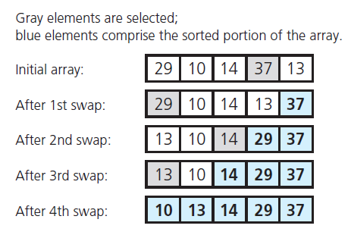
The Selection Sort
FIGURE 11-1 A selection sort of an array of five integers
Data Structures and Problem Solving with C++: Walls and Mirrors, Carrano and Henry, © 2013

Slide 5
The Selection Sort
View implementation of the selection sort,
Listing 11-1
Analysis
  This is an O (n² ) algorithm
If sorting a very large array, selection sort algorithm probably too inefficient to use
.htm code listing files must be in the same folder as the .ppt files for these links to work
Data Structures and Problem Solving with C++: Walls and Mirrors, Carrano and Henry, © 2013

Slide 6
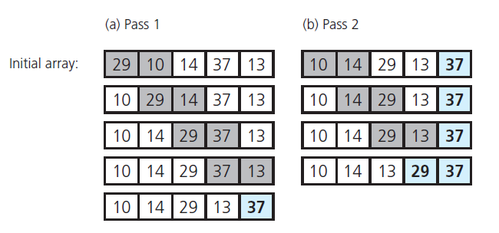
The Bubble Sort
FIGURE 11-2 The first two passes of a bubble sort
of an array of five integers
Data Structures and Problem Solving with C++: Walls and Mirrors, Carrano and Henry, © 2013

Slide 7
The Bubble Sort
View an implementation of the bubble sort,
Listing 11-2
Analysis
  Best case, O(n) algorithm
  Worst case, O(n²) algorithm
Again, a poor choice for large amounts of data
Data Structures and Problem Solving with C++: Walls and Mirrors, Carrano and Henry, © 2013

Slide 8
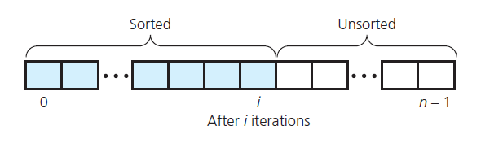
The Insertion Sort
Take each item from unsorted region, insert into its correct order in sorted region
FIGURE 11-3 An insertion sort partitions
the array into two regions
Data Structures and Problem Solving with C++: Walls and Mirrors, Carrano and Henry, © 2013

Slide 9
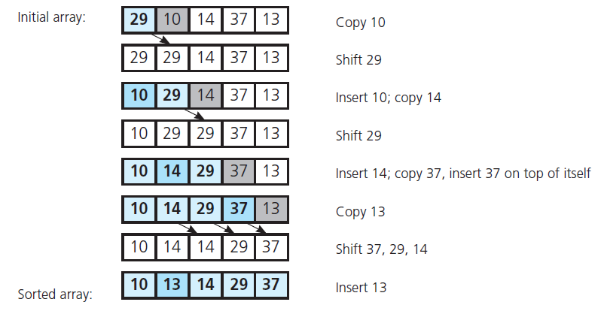
The Insertion Sort
FIGURE 11-4 An insertion sort of an
array of five integers
Data Structures and Problem Solving with C++: Walls and Mirrors, Carrano and Henry, © 2013

Slide 10
The Insertion Sort
View implantation of insertion sort,
Listing 11-3
Analysis
  An algorithm of order O(n²)
  Best case O(n)
Appropriate for 25 or less data items
Data Structures and Problem Solving with C++: Walls and Mirrors, Carrano and Henry, © 2013

Slide 11
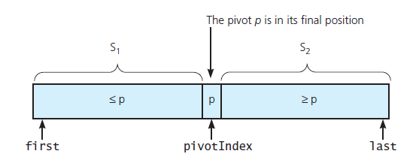
The Quick Sort
FIGURE 11-9 A partition about a pivot
Data Structures and Problem Solving with C++: Walls and Mirrors, Carrano and Henry, © 2013

Slide 12
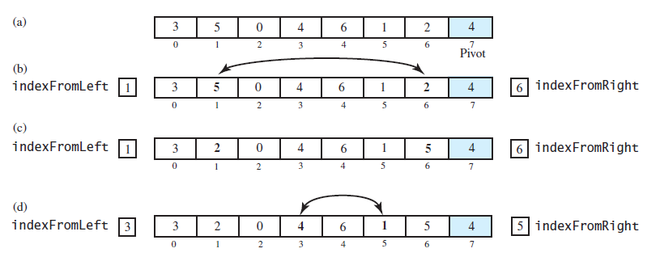
The Quick Sort
FIGURE 11-10 Partitioning of array during quick sort
Data Structures and Problem Solving with C++: Walls and Mirrors, Carrano and Henry, © 2013

Slide 13
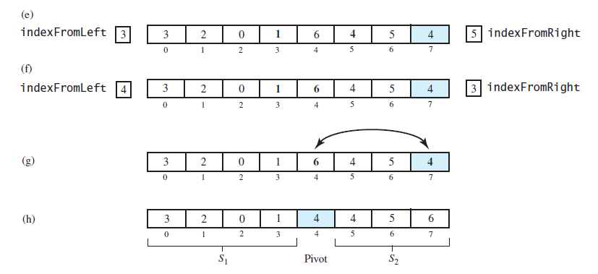
The Quick Sort
FIGURE 11-10 Partitioning of array during quick sort
Data Structures and Problem Solving with C++: Walls and Mirrors, Carrano and Henry, © 2013

Slide 14
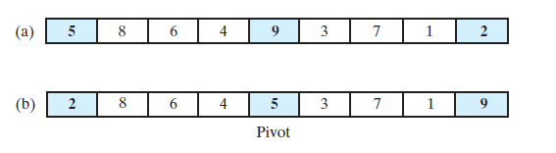
The Quick Sort
FIGURE 11-11 Median-of-three pivot selection:
(a) The original array; (b) the array with its
first, middle, and last entries sorted
Data Structures and Problem Solving with C++: Walls and Mirrors, Carrano and Henry, © 2013

Slide 15
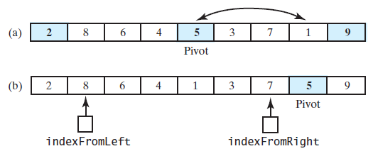
The Quick Sort
FIGURE 11-12 (a) The array with its first, middle, and last entries sorted; (b) the array after positioning the pivot and just before partitioning
Data Structures and Problem Solving with C++: Walls and Mirrors, Carrano and Henry, © 2013

Slide 16
The Quick Sort
Note function that performs a quick sort,
Listing 11-5
Analysis
  Worst case O(n²)
  Average case O(n × log n)
  Does not require extra memory like merge sort
Data Structures and Problem Solving with C++: Walls and Mirrors, Carrano and Henry, © 2013

Slide 17
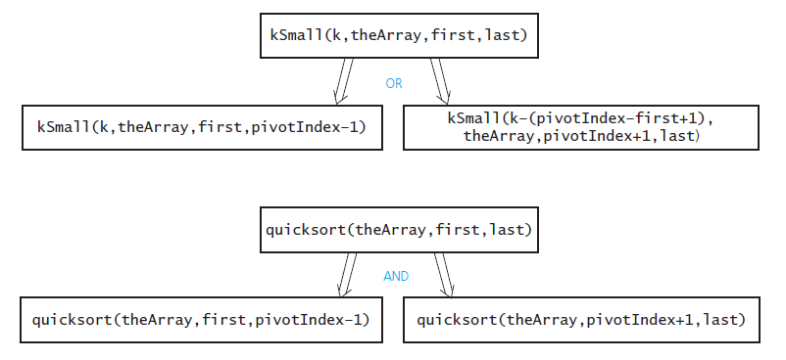
The Quick Sort
FIGURE 11-13 kSmall versus quickSort
Data Structures and Problem Solving with C++: Walls and Mirrors, Carrano and Henry, © 2013

Slide 18
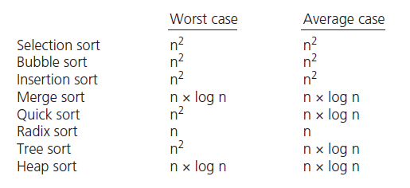
Comparison of Sorting Algorithms
FIGURE 11-15 Approximate growth rates of time required for eight sorting algorithms
Data Structures and Problem Solving with C++: Walls and Mirrors, Carrano and Henry, © 2013

Slide 19
End
Chapter 11
Data Structures and Problem Solving with C++: Walls and Mirrors, Carrano and Henry, © 2013

